Slide 1
Natural Language Processing
Yue Zhang
Westlake University

Slide 2
Roadmap
Week 2
Overview of NLP architecture
Data and Model
Review of background
Linear Models
Week 3
Week 4
Week 5
Week 6
Week 7
N-gram Language Models
Naïve Bayes
Generative Text Classification
Features
Document Representation
Discriminative Text Classification
Neuron
SGD
Entropy, Perplexity
Word Representation
HMM -- Generative Sturctured Prediction
CRF – Discriminative Structured Prediction
Neural Models
Week 8
Week 10
Week 12
MLP, Multi-Layer Perception
Neural N-gram LM and Word Embedding
Neural Structured Prediction
Sequence-to-sequence
Neural Recurrent Language Models
Week 9
Week 13
Sequence Representation
Neural Text Classification
Week 11
Sequence-level Pre-training
Pre-trained Models for Text Classification and other MLP tasks
Structured Representation
Large Language Models
Week 14
Week 15
Scaling, instruction following and LLMs
LLMs for NLP, AGI and beyond

Slide 3
Week 8
Neural Networks

Slide 4
Contents
8.1 From One Layer to Multiple Layers
8.1.1 Multi-Layer Perceptron for Text Classification
8.1.2 Analyzing Representation
8.1.3 Training a Multi-Layer Perceptron
8.2 Neural Language Models and Word Embedding
8.2.1 Neural n-gram Language Modelling
8.2.2 Fast Training
8.2.3 Word Embeddings

Slide 5
Contents
8.1 From One Layer to Multiple Layers
8.1.1 Multi-Layer Perceptron for Text Classification
8.1.2 Analyzing Representation
8.1.3 Training a Multi-Layer Perceptron
8.2 Neural Language Models and Word Embedding
8.2.1 Neural n-gram Language Modelling
8.2.2 Fast Training
8.2.3 Word Embeddings

Slide 6
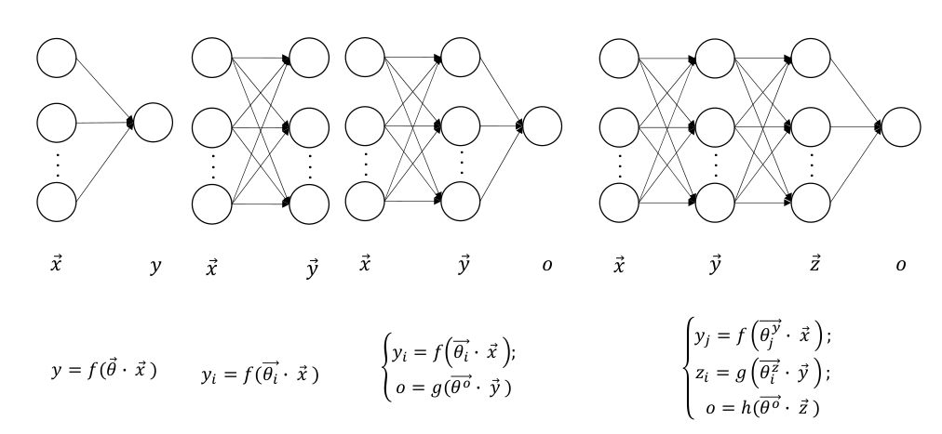
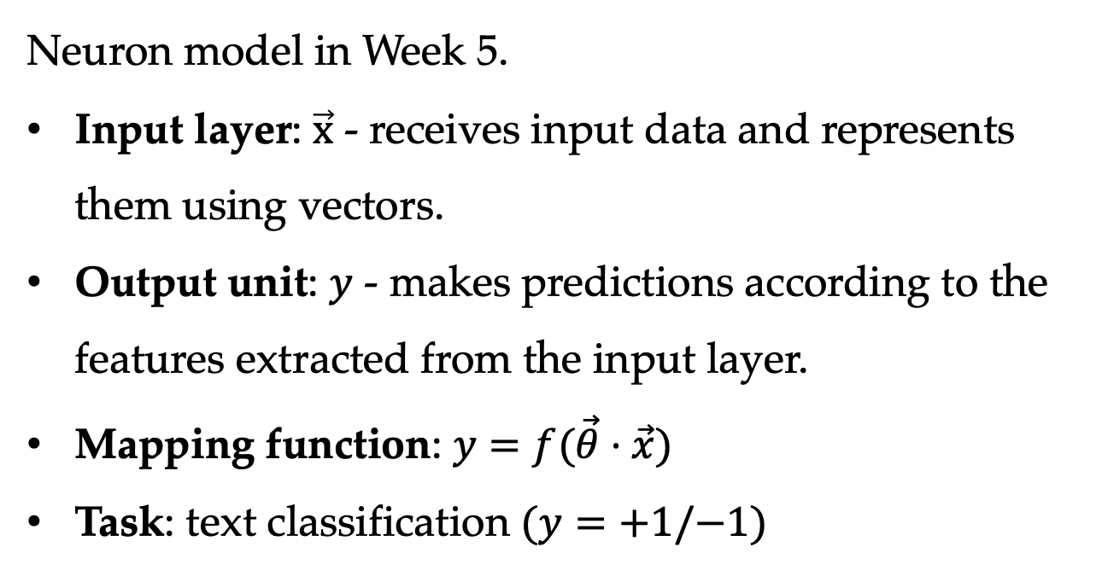
Single-Layer Perceptron
Neuron model in Week 5.
Input layer: $\vec{x}$ - receives input data and represents them using vectors.
Output unit: $y$ - makes predictions according to the features extracted from the input layer.
Mapping function: $y=f(\vec{θ}⋅\vec{x})$
Task: text classification $(y=+1/−1)$
6

Slide 7
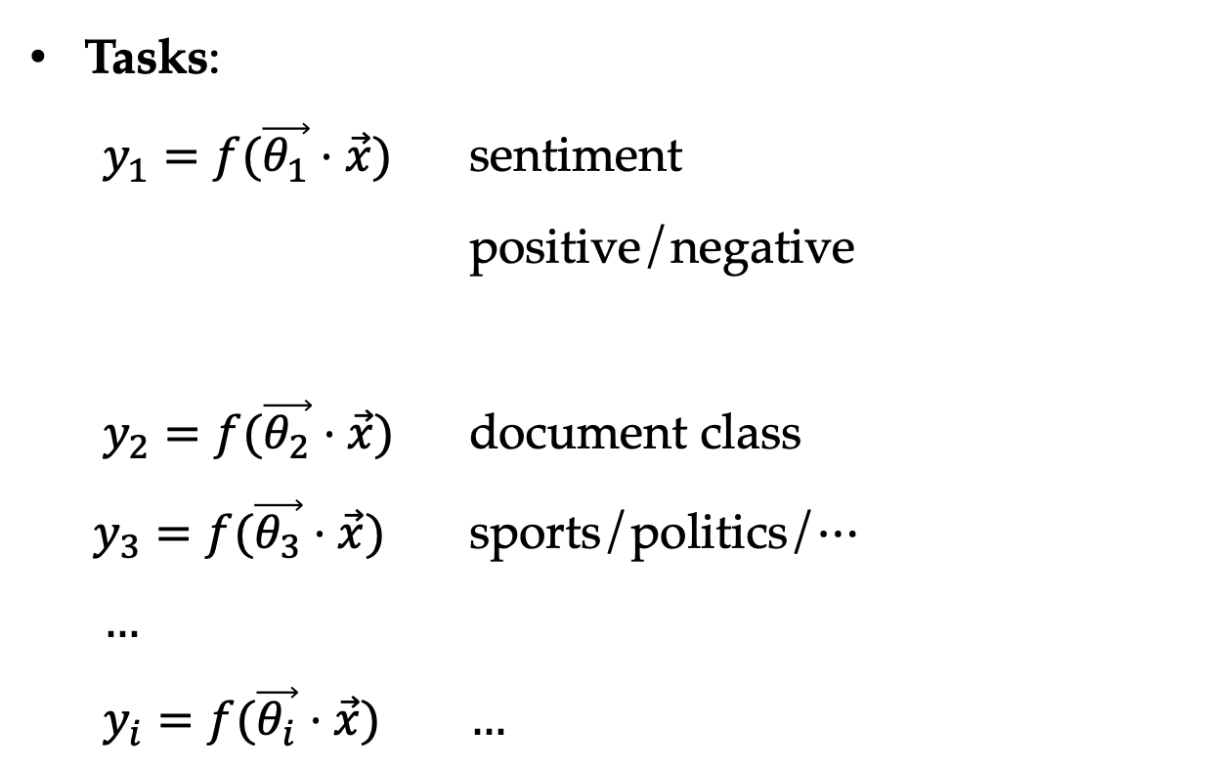
Multi-outputs
Tasks:
$y_{1}=f(\vec{θ_{1}}⋅\vec{x})$ sentiment positive/negative
$y_{2}=f(\vec{θ_{2}}⋅\vec{x})$ document class
$y_{3}=f(\vec{θ_{3}}⋅\vec{x})$ sports/politics/$…$
$…$
$y_{i}=f(\vec{θ_{i}}⋅\vec{x})$ $…$

Slide 8
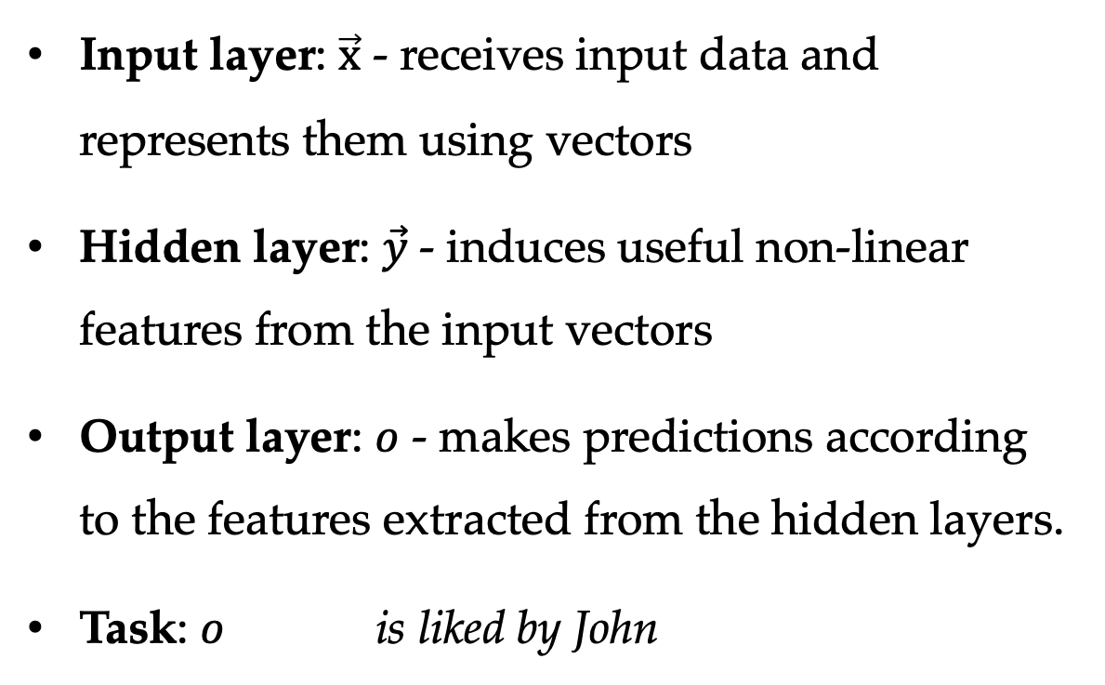
Two-Layers
Input layer: $\vec{x}$ - receives input data and represents them using vectors
Hidden layer: $\vec{y}$- induces useful non-linear features from the input vectors
Output layer: $o$ - makes predictions according to the features extracted from the hidden layers.
Task: $o$ is liked by John

Slide 9
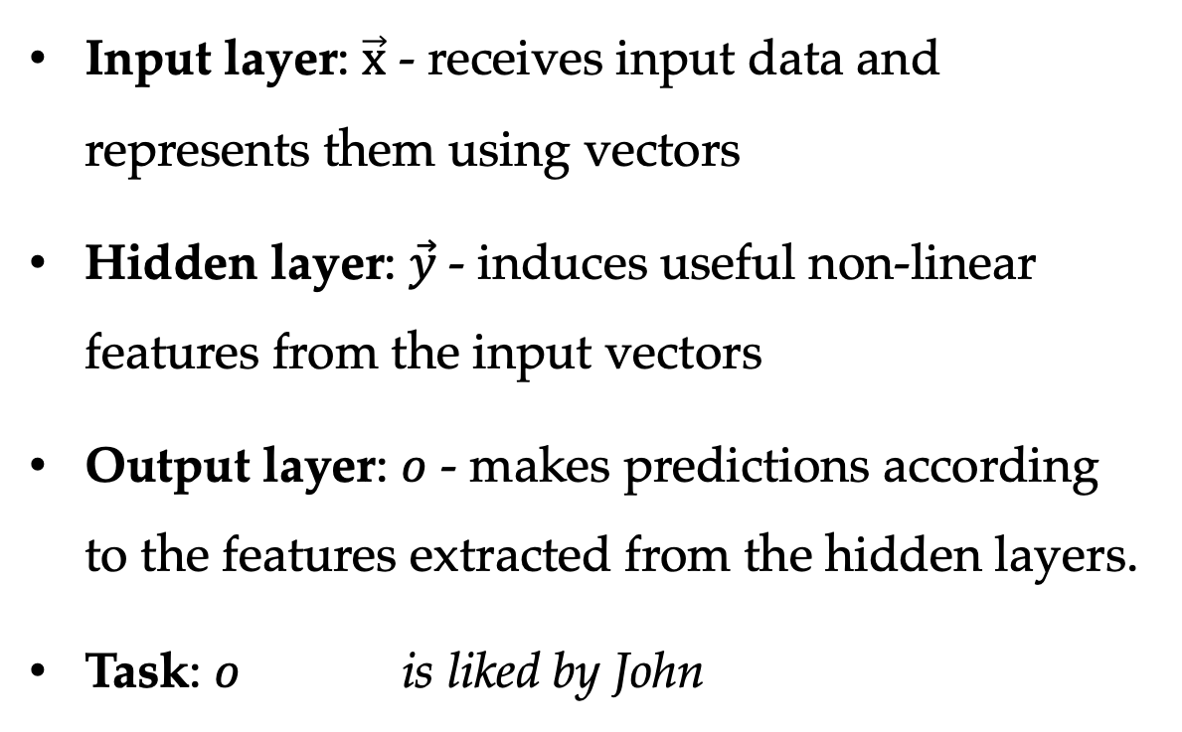
Two-Layers Perceptron
Input layer: $\vec{x}$ - receives input data and represents them using vectors
Hidden layer: $\vec{y}$- induces useful non-linear features from the input vectors
Output layer: $o$ - makes predictions according to the features extracted from the hidden layers.
Task: $o$ is liked by John
End-to-end training using ($\vec{x}$, $o$) data, $\vec{y}$ is automatically learned.

Slide 10
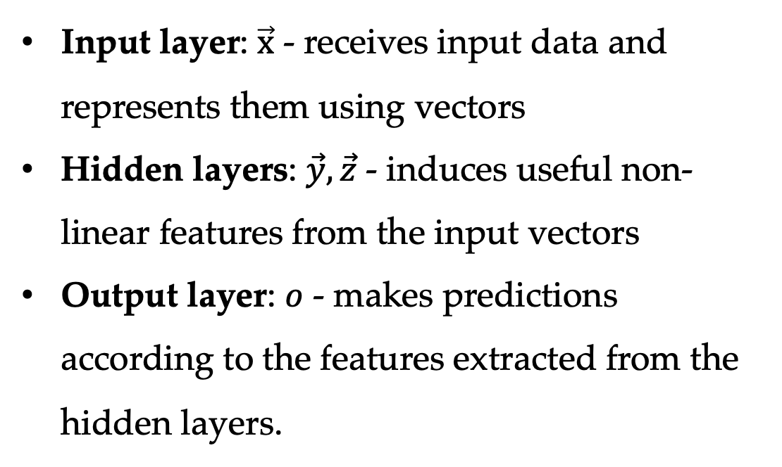
Three-Layers
Input layer: $\vec{x}$ - receives input data and represents them using vectors
Hidden layers: $\vec{y},\vec{z}$ - induces useful non-linear features from the input vectors
Output layer: $o$ - makes predictions according to the features extracted from the hidden layers.

Slide 11
Multi-Layer Perceptron (NLP)
Two-layer and three-layer perceptron are called multi-layer perceptrons.
They are both non-linear.
Non-linear activation is key to representation power.

Slide 12
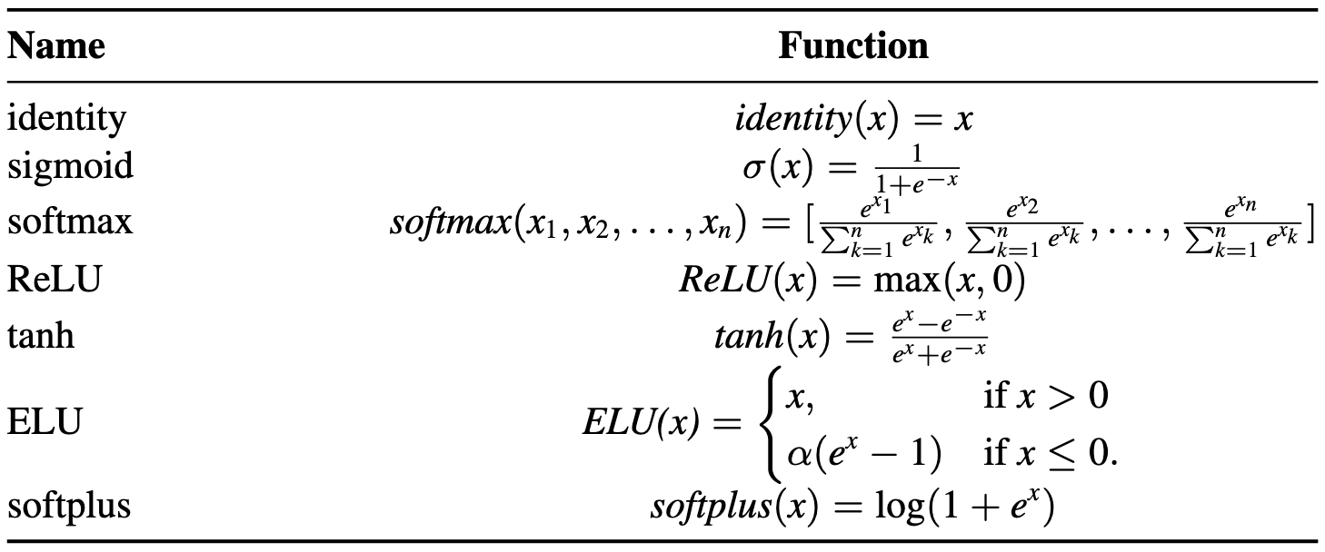
Activation Function
Non-linear activation functions

Slide 13
Contents
8.1 From One Layer to Multiple Layers
8.1.1 Multi-Layer Perceptron for Text Classification
8.1.2 Analyzing Representation
8.1.3 Training a Multi-Layer Perceptron
8.2 Neural Language Models and Word Embedding
8.2.1 Neural n-gram Language Modelling
8.2.2 Fast Training
8.2.3 Word Embeddings

Slide 14
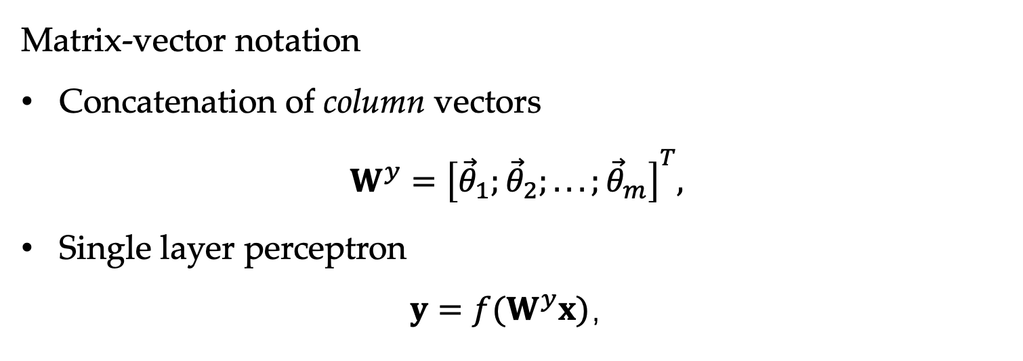
Neural Network Notation
Matrix-vector notation
Concatenation of column vectors
$$W^{y}={\left[{\vec{θ}}_{1};{\vec{θ}}_{2};...;{\vec{θ}}_{m}\right]}^{T},$$
Single layer perceptron
$$y=f(W^{y}x)，$$

Slide 15
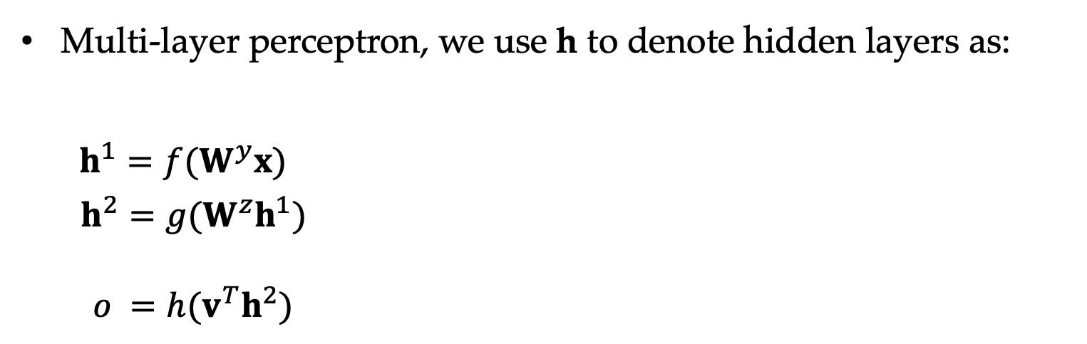
Matrix Vector Notation
Multi-layer perceptron, we use h to denote hidden layers as:
$$\begin{aligned}h^{1}=f(W^{y}x) \\ h^{2}=g(W^{z}h^{1}) \\ \end{aligned}$$
$o =h(v^{T}h^{2})$

Slide 16
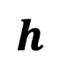

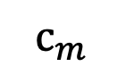
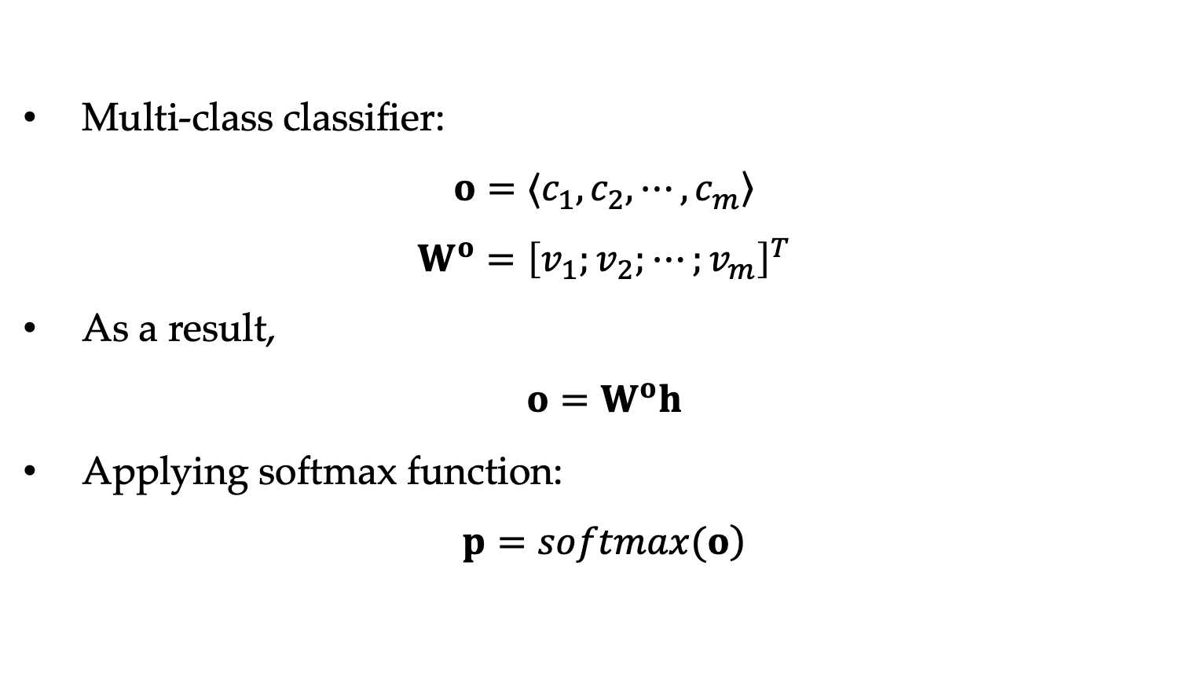
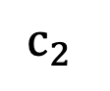
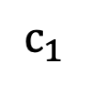

Matrix Vector Notation
Multi-class classifier:
$$o=〈c_{1},c_{2},⋯,c_{m}〉$$
$$W^{o}={\left[v_{1};v_{2};⋯;v_{m}\right]}^{T}$$
As a result,
$$o=W^{o}h$$
Applying softmax function:
$$\left.p=softmax(o\right)$$
$$h$$
$$c_{1}$$
$$x$$
$$c_{2}$$
$$o$$
…
…
…
$$c_{m}$$

Slide 17
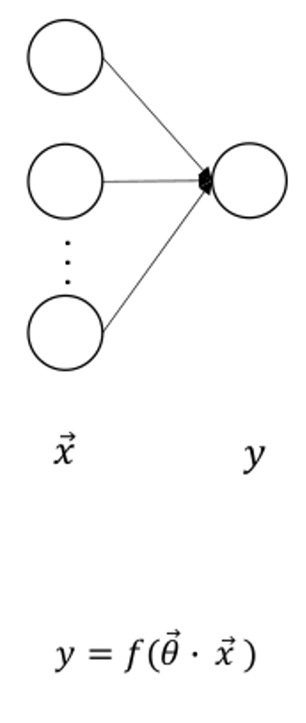
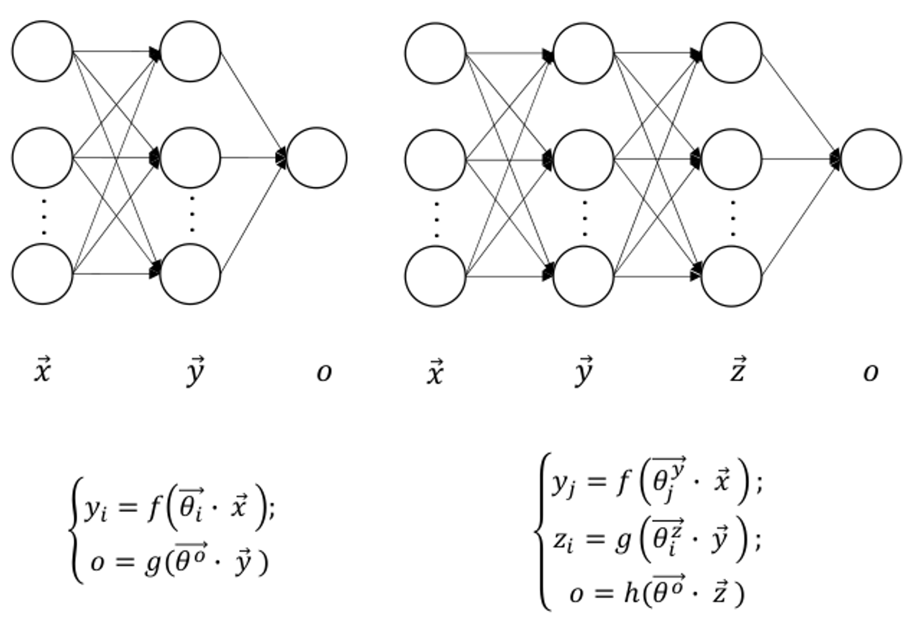
Correlation with Linear Classifier
From a single layer to multiple layers:
Single-Layer
Multi-Layer
Perceptrons can only learn linear features.
MLP model can learn non-linear mappings between input and output.
Universal approximation theory.
17

Slide 18




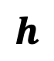

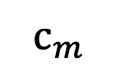
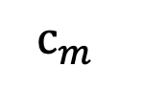
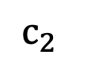
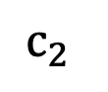
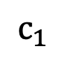
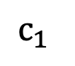

Correlation with Linear Classifier
No matter for binary or multi-class classification, MLP differs from linear perceptron only in the use of hidden layers.
$$h$$
$$c_{1}$$
$$c_{1}$$
$$x$$
$$c_{2}$$
$$o$$
$$x$$
$$c_{2}$$
$$o$$
…
…
…
…
$$c_{m}$$
…
$$c_{m}$$
Score(c) $=w^{°}$x
Score(c) $=w^{°}h$
Single-layer perceptron for multiclass classification
Multi-layer perceptron for multiclass classification

Slide 19
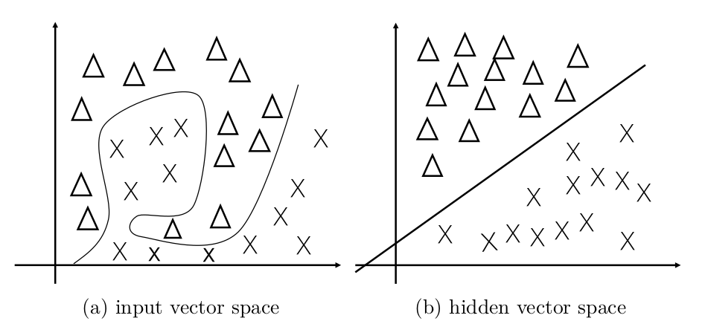
Characteristics of Neural Hidden Layers
Low dimensional
Dense, with nodes in real numbers
Dynamically calculated
The representation power of hidden layer representation.
Notes:
Add equation and figure
Extend feature vector ⬄ extend parameter vector

Slide 20
Contents
8.1 From One Layer to Multiple Layers
8.1.1 Multi-Layer Perceptron for Text Classification
8.1.2 Analyzing Representation
8.1.3 Training a Multi-Layer Perceptron
8.2 Neural Language Models and Word Embedding
8.2.1 Neural n-gram Language Modelling
8.2.2 Fast Training
8.2.3 Word Embeddings

Slide 21
Analyzing Representation
The neural representation vector h
Dynamically computed low-dimensional dense
Pros
contain automatic combinations of input features
capturing syntactic and semantic information
Cons
not easily interpretable

Slide 22
Analyzing Representation
Visualization
Projecting hidden representations into a two-dimensional figure to better understand their correlations
Preserving the distance correlation between vectors to gain knowledge about the characteristics of the representation vectors
A useful tool: t-distributed stochastic neighbor embedding (t-SNE)

Slide 23
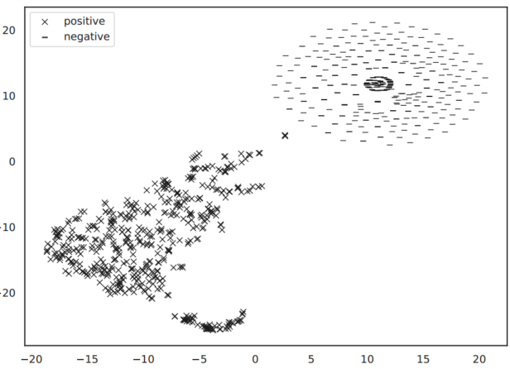
Analyzing Representation
t-distributed stochastic neighbor embedding ( t-SNE)
A non-linear dimensionality reduction technique that aims to preserve the distance correlation between vectors in the original high-dimensional vector space and then projected to two-dimensional space.
An example of t-SNE visualization of positive and negative documents.

Slide 24
Contents
8.1 From One Layer to Multiple Layers
8.1.1 Multi-Layer Perceptron for Text Classification
8.1.2 Analyzing Representation
8.1.3 Training a Multi-Layer Perceptron
8.2 Neural Language Models and Word Embedding
8.2.1 Neural n-gram Language Modelling
8.2.2 Fast Training
8.2.3 Word Embeddings

Slide 25
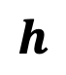
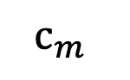
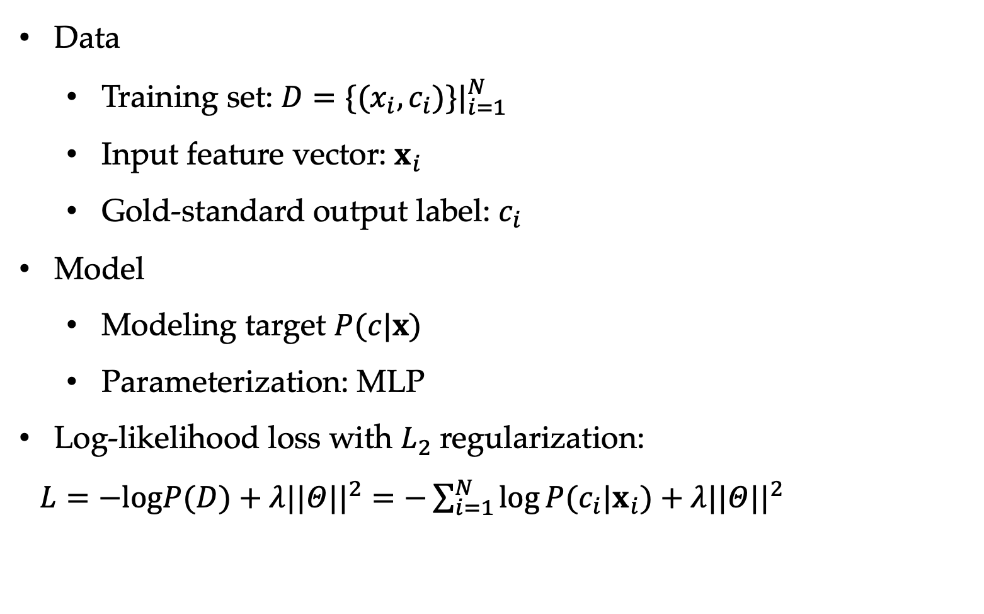
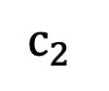
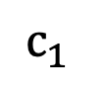

Training Multi-layer Perceptrons
Data
Training set: $D=\{(x_{i},c_{i})\}|_{i=1}^{N}$
Input feature vector: $x_{i}$
Gold-standard output label: $c_{i}$
Model
Modeling target $P(c|x)$
Parameterization: MLP
Log-likelihood loss with $L_{2}$ regularization:
$L=−logP(D)+λ||Θ||^{2}=−\sum_{i=1}^{N}{log}P(c_{i}|x_{i})+λ||Θ||^{2}$
$$h$$
$$c_{1}$$
$$x$$
$$c_{2}$$
$$o$$
…
…
…
$$c_{m}$$

Slide 26

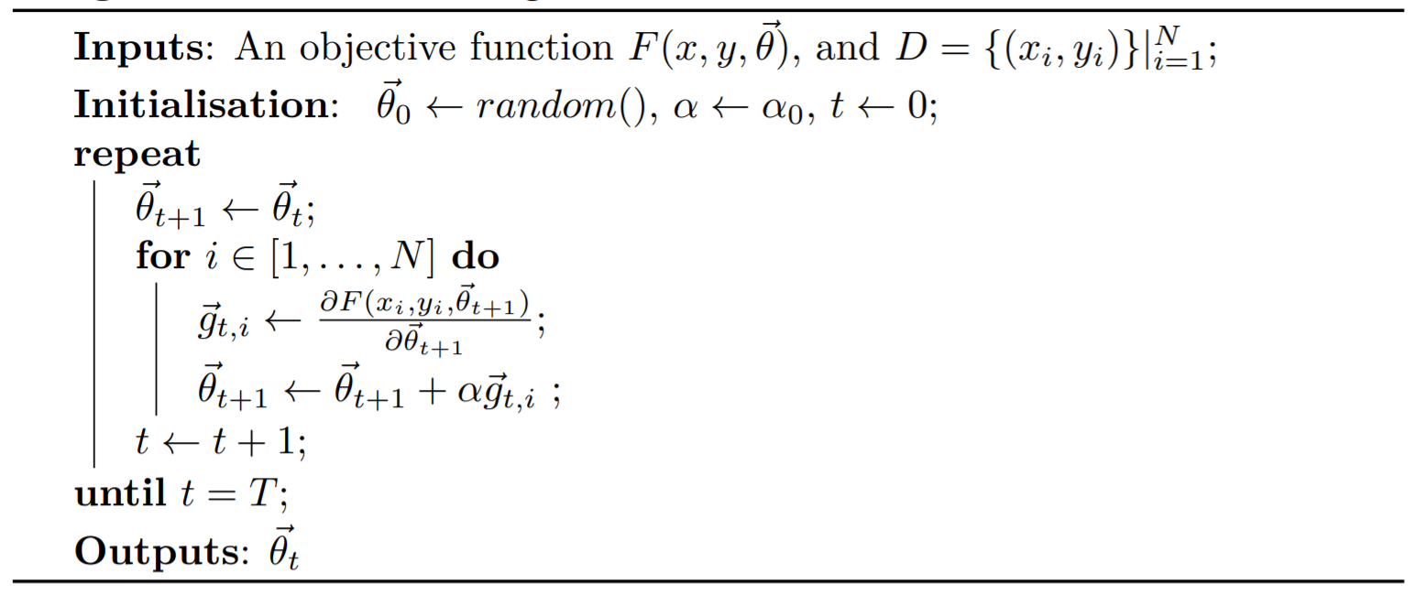
Training using SGD
Stochastic Gradient Descent
Notes:
Algorithm 4.1-4.3

Slide 27
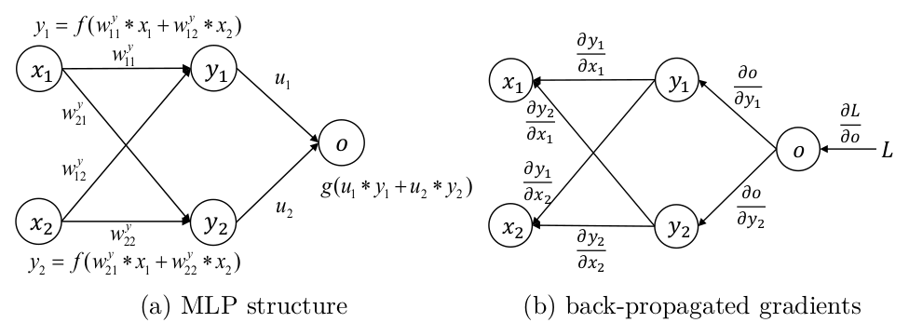
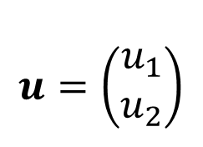
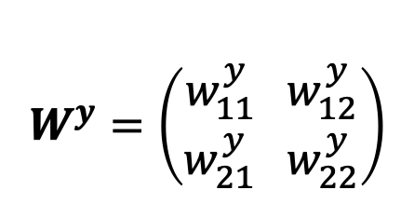
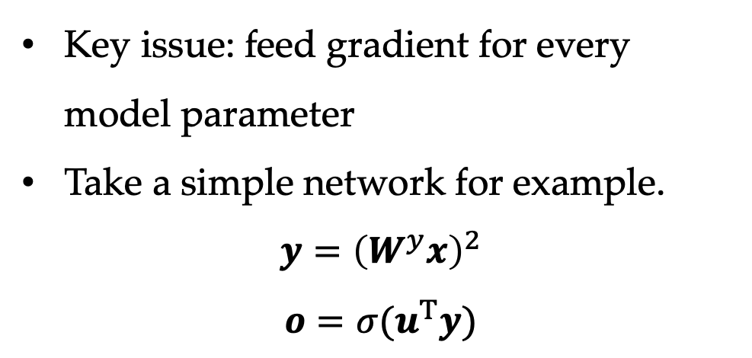
Training a Neural Network
Key issue: feed gradient for every model parameter
Take a simple network for example.
$$y={\left(W^{y}x\right)}^{2}$$
$$o=σ(u^{T}y)$$
$$W^{y}=\left(\begin{aligned}w_{11}^{y} w_{12}^{y} \\ w_{21}^{y} w_{22}^{y}\end{aligned}\right)$$
$$u=\left(\begin{aligned}u_{1} \\ u_{2}\end{aligned}\right)$$

Slide 28
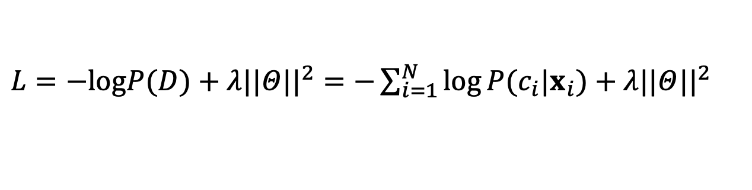
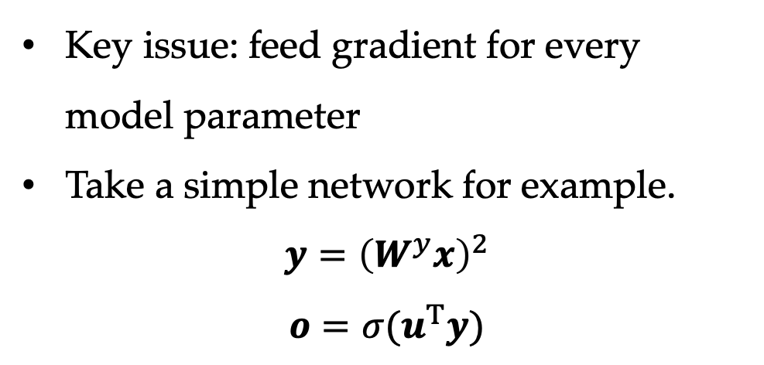
Training a Neural Network
Key issue: feed gradient for every model parameter
Take a simple network for example.
$$y={\left(W^{y}x\right)}^{2}$$
$$o=σ(u^{T}y)$$
$$W^{y}=\left(\begin{aligned}w_{11}^{y} w_{12}^{y} \\ w_{21}^{y} w_{22}^{y}\end{aligned}\right)$$
$$u=\left(\begin{aligned}u_{1} \\ u_{2}\end{aligned}\right)$$
$L=−logP(D)+λ||Θ||^{2}=−\sum_{i=1}^{N}{log}P(c_{i}|x_{i})+λ||Θ||^{2}$

Slide 29
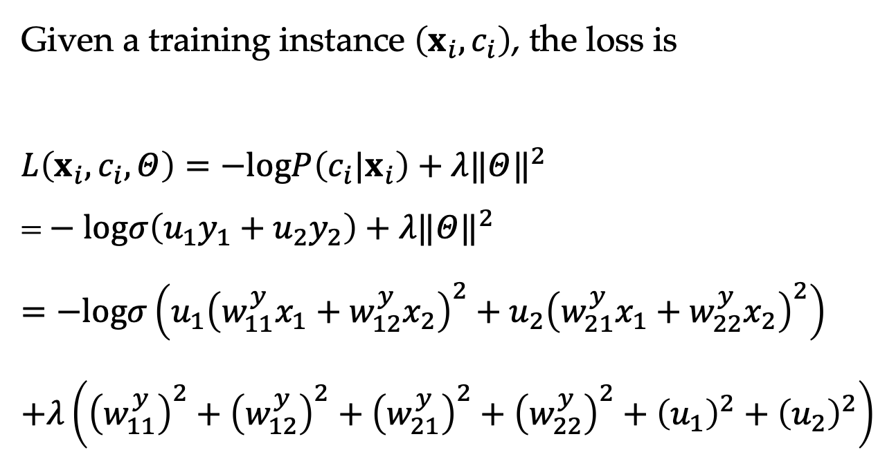
Gradients
Given a training instance $\left(x_{i},c_{i}\right)$, the loss is
$L\left(x_{i},c_{i},Θ\right)=−logP\left(c_{i}|x_{i}\right)+λ‖Θ‖^{2}$
$\text{=}−logσ\left(u_{1}y_{1}+u_{2}y_{2}\right)+λ‖Θ‖^{2}$
$=−logσ\left(u_{1}{\left(w_{11}^{y}x_{1}+w_{12}^{y}x_{2}\right)}^{2}+u_{2}{\left(w_{21}^{y}x_{1}+w_{22}^{y}x_{2}\right)}^{2}\right)$
$+λ\left({\left(w_{11}^{y}\right)}^{2}+{\left(w_{12}^{y}\right)}^{2}+{\left(w_{21}^{y}\right)}^{2}+{\left(w_{22}^{y}\right)}^{2}+{\left(u_{1}\right)}^{2}+{\left(u_{2}\right)}^{2}\right)$

Slide 30
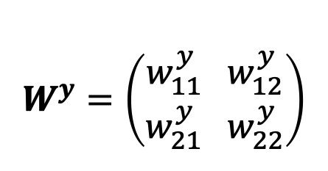
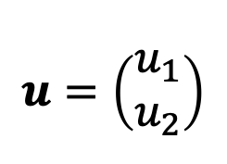
Gradients
Given a training instance $\left(x_{i},c_{i}\right)$, the loss is
$L\left(x_{i},c_{i},Θ\right)=−logP\left(c_{i}|x_{i}\right)+λ‖Θ‖^{2}$
$\text{=}−logσ\left(u_{1}y_{1}+u_{2}y_{2}\right)+λ‖Θ‖^{2}$
$=−logσ\left(u_{1}{\left(w_{11}^{y}x_{1}+w_{12}^{y}x_{2}\right)}^{2}+u_{2}{\left(w_{21}^{y}x_{1}+w_{22}^{y}x_{2}\right)}^{2}\right)$
$+λ\left({\left(w_{11}^{y}\right)}^{2}+{\left(w_{12}^{y}\right)}^{2}+{\left(w_{21}^{y}\right)}^{2}+{\left(w_{22}^{y}\right)}^{2}+{\left(u_{1}\right)}^{2}+{\left(u_{2}\right)}^{2}\right)$
$$W^{y}=\left(\begin{aligned}w_{11}^{y} w_{12}^{y} \\ w_{21}^{y} w_{22}^{y}\end{aligned}\right)$$
$$u=\left(\begin{aligned}u_{1} \\ u_{2}\end{aligned}\right)$$
Need gradients for

Slide 31
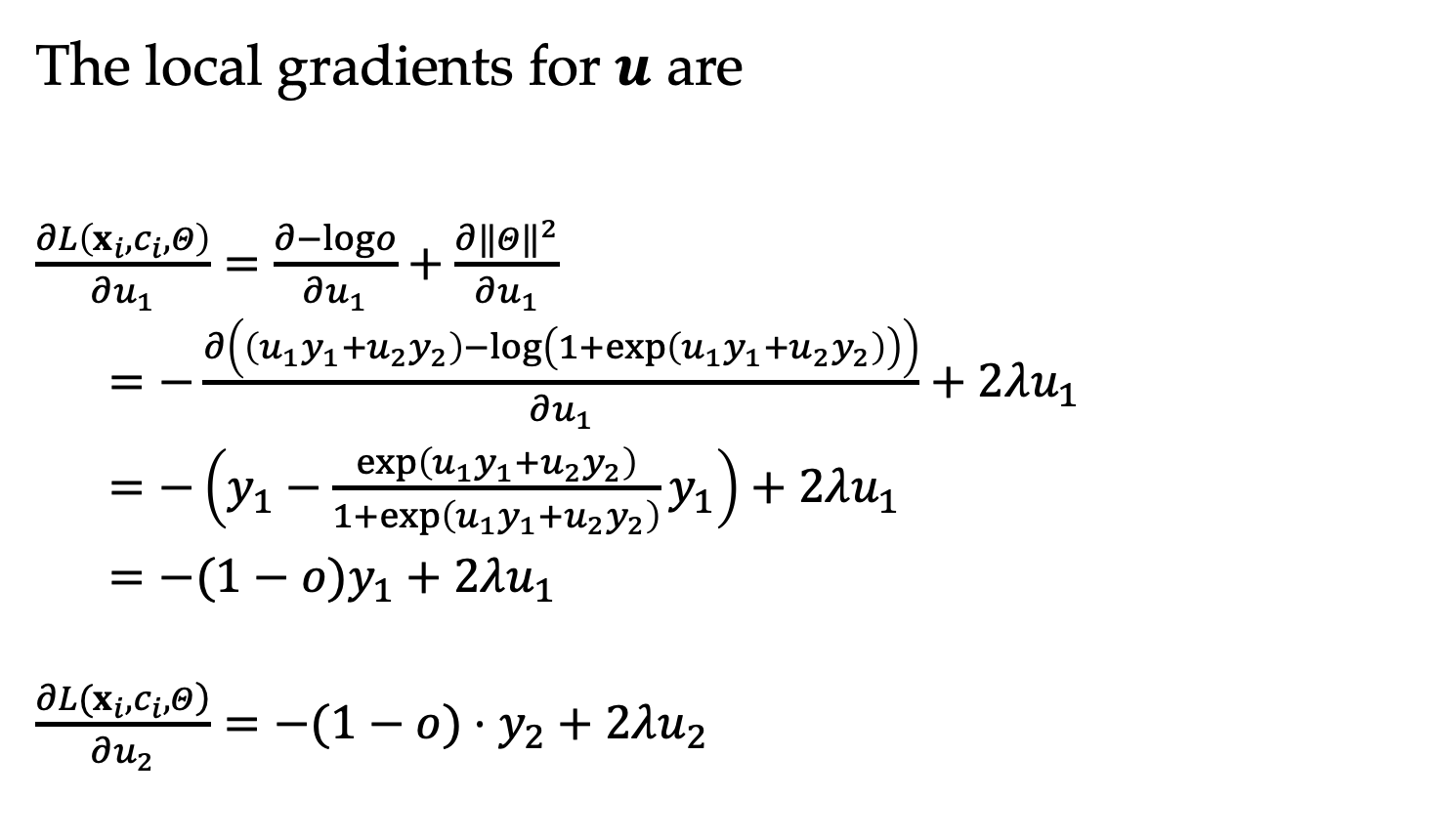
Gradients
The local gradients for $u$ are
$\frac{∂L\left(x_{i},c_{i},Θ\right)}{∂u_{1}}=\frac{∂−logo}{∂u_{1}}+\frac{∂‖Θ‖^{2}}{∂u_{1}}$
$=−\frac{∂\left(\left(u_{1}y_{1}+u_{2}y_{2}\right)−log\left(1+exp\left(u_{1}y_{1}+u_{2}y_{2}\right)\right)\right)}{∂u_{1}}+2λu_{1}$
$=−\left(y_{1}−\frac{exp\left(u_{1}y_{1}+u_{2}y_{2}\right)}{1+exp\left(u_{1}y_{1}+u_{2}y_{2}\right)}y_{1}\right)+2λu_{1}$
$=−(1−o)y_{1}+2λu_{1}$
$\frac{\left.∂L(x_{i},c_{i},Θ\right)}{∂u_{2}}=−(1−o)⋅y_{2}+2λu_{2}$

Slide 32
Gradients
The local gradients for $u$ are
$\frac{∂L\left(x_{i},c_{i},Θ\right)}{∂u_{1}}=\frac{∂−logo}{∂u_{1}}+\frac{∂‖Θ‖^{2}}{∂u_{1}}$
$=−\frac{∂\left(\left(u_{1}y_{1}+u_{2}y_{2}\right)−log\left(1+exp\left(u_{1}y_{1}+u_{2}y_{2}\right)\right)\right)}{∂u_{1}}+2λu_{1}$
$=−\left(y_{1}−\frac{exp\left(u_{1}y_{1}+u_{2}y_{2}\right)}{1+exp\left(u_{1}y_{1}+u_{2}y_{2}\right)}y_{1}\right)+2λu_{1}$
$=−(1−o)y_{1}+2λu_{1}$
$\frac{\left.∂L(x_{i},c_{i},Θ\right)}{∂u_{2}}=−(1−o)⋅y_{2}+2λu_{2}$
Note: The gradients have and in them.
(need to do forward computation)

Slide 33
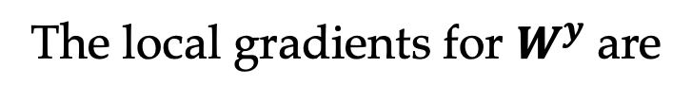
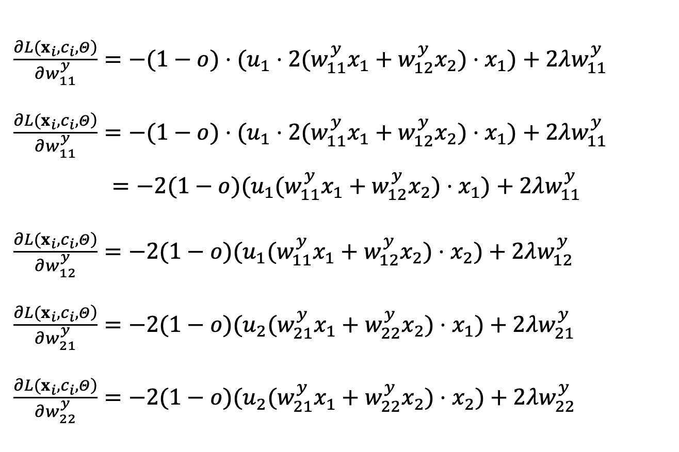
Gradients
The local gradients for $W^{y}$ are
$\frac{\left.∂L(x_{i},c_{i},Θ\right)}{∂w_{11}^{y}}=−(1−o)⋅(u_{1}⋅2(w_{11}^{y}x_{1}+w_{12}^{y}x_{2})⋅x_{1})+2λw_{11}^{y}$
$\frac{\left.∂L(x_{i},c_{i},Θ\right)}{∂w_{11}^{y}}=−(1−o)⋅(u_{1}⋅2(w_{11}^{y}x_{1}+w_{12}^{y}x_{2})⋅x_{1})+2λw_{11}^{y}$
$=−2(1−o)(u_{1}(w_{11}^{y}x_{1}+w_{12}^{y}x_{2})⋅x_{1})+2λw_{11}^{y}$
$\frac{\left.∂L(x_{i},c_{i},Θ\right)}{∂w_{12}^{y}}=−2(1−o)(u_{1}(w_{11}^{y}x_{1}+w_{12}^{y}x_{2})⋅x_{2})+2λw_{12}^{y}$
$\frac{\left.∂L(x_{i},c_{i},Θ\right)}{∂w_{21}^{y}}=−2(1−o)(u_{2}(w_{21}^{y}x_{1}+w_{22}^{y}x_{2})⋅x_{1})+2λw_{21}^{y}$
$\frac{\left.∂L(x_{i},c_{i},Θ\right)}{∂w_{22}^{y}}=−2(1−o)(u_{2}(w_{21}^{y}x_{1}+w_{22}^{y}x_{2})⋅x_{2})+2λw_{22}^{y}$

Slide 34
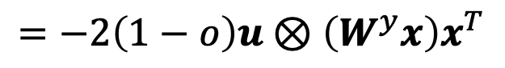
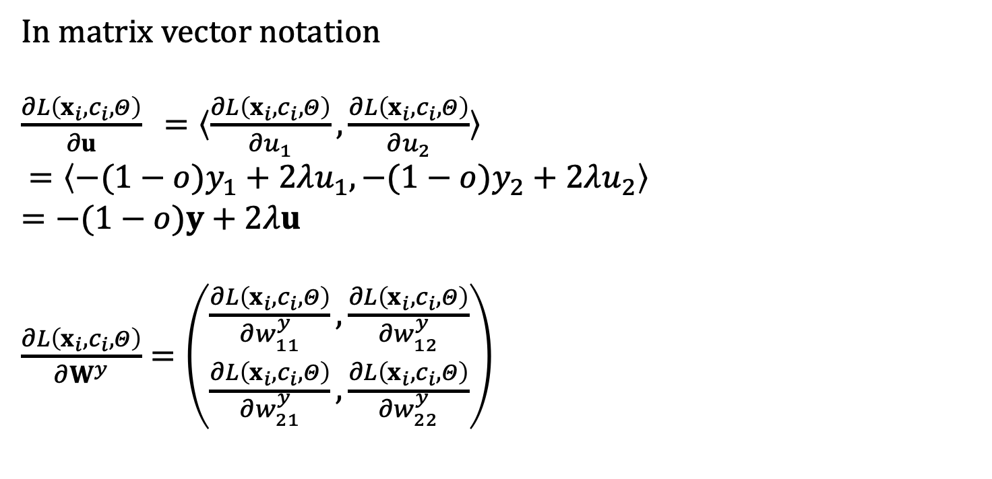
Matrix-vector Notation of Gradients
In matrix vector notation
$\frac{∂L\left(x_{i},c_{i},Θ\right)}{∂u} =〈\frac{∂L\left(x_{i},c_{i},Θ\right)}{∂u_{1}},\frac{∂L\left(x_{i},c_{i},Θ\right)}{∂u_{2}}〉$
$=〈−(1−o)y_{1}+2λu_{1},−(1−o)y_{2}+2λu_{2}〉$
$=−(1−o)y+2λu$
$\frac{∂L\left(x_{i},c_{i},Θ\right)}{∂W^{y}}=\left(\begin{matrix}\frac{∂L\left(x_{i},c_{i},Θ\right)}{∂w_{11}^{y}},\frac{∂L\left(x_{i},c_{i},Θ\right)}{∂w_{12}^{y}} \\ \frac{∂L\left(x_{i},c_{i},Θ\right)}{∂w_{21}^{y}},\frac{∂L\left(x_{i},c_{i},Θ\right)}{∂w_{22}^{y}}\end{matrix}\right)$
$$=−2\left(1−o\right)u⊗\left(W^{y}x\right)x^{T}$$
Cannot do direct vector-level and matrix-level gradient calculation.

Slide 35
Back-propagation
The above process is tedious for large neural nets

Slide 36
Back-propagation
The above process is tedious for large neural nets
Solution: perform modularized and incremental gradient calculation
Chain rule!
Back-propagation allows modularization of neural network components in deep networks
the forward computation
the back-propagation rule
the partial derivative of the loss with respect to the model parameters
the partial derivative of the loss with respect to the input layer

Slide 37

Computation Graph
The two steps
(a) forward values
(b) gradients

Slide 38
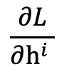
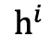
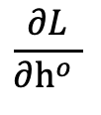
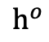

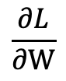
Back-propagation
L —— overall loss
Layer structure
For each layer
the structure – input to output
the input -- gradient on output nodes
compute the partial derivative with respect to
the model parameters
the input nodes
… …
$$h^{o}$$
$$W$$
… …
$$h^{i}$$
Given
$$\frac{∂L}{∂h^{o} }$$
Calculate
$$\frac{∂L}{∂h^{i} }$$
—— for previous layer
$$\frac{∂L}{∂W}$$
—— for parameter

Slide 39

Back-propagation Example
For the MLP
$$y={\left(W^{y}x\right)}^{2}, o=σ\left(u^{T}⋅y\right)$$
For SGD, the local loss is
$$L(x,c,Θ)=L^{o}+‖Θ‖^{2}$$
For the layer $y→o$, input is $\frac{∂L^{o}}{∂o}$
$$\frac{∂L^{o}}{∂u}=\frac{∂L^{o}}{∂o}⋅o(1−o)y$$
$$\frac{∂L^{o}}{∂y}=\frac{∂L^{o}}{∂o}⋅o(1−o)u$$
For the layer $x→y$, input is $\frac{∂L^{o}}{∂y}$
$$\frac{∂L^{o}}{∂W^{y}}=\frac{∂L^{o}}{∂y}⊗\left(2W^{y}x\right)⋅x^{T}$$

Slide 40

Back-propagation

Slide 41

Back-propagation
Insert into SGD!

Slide 42


Parameter Initialization
All zero initialization does not work.
Given a model parameter $W$, initialization of each element in $W$ include.
Xavier Uniform Initialization.$W\sim 𝒰\left(−\sqrt{\frac{6}{d_{l}+d_{l−1}}},\sqrt{\frac{6}{d_{l}+d_{l−1}}}\right)$
Xavier Normal Initialization.$W\sim 𝒩\left(0,\frac{2}{d_{l}+d_{l−1}}\right)$
Kaiming Uniform Initialization.$W\sim 𝒰\left(−\sqrt{\frac{6}{d_{l−1}}},\sqrt{\frac{6}{d_{l−1}}}\right)$
Kaiming Normal Initialization.$W\sim 𝒩\left(0,\frac{2}{d_{l−1}}\right)$
$d_{l}$ —— layer $l$ hidden size.
Notes:
Randomly init hidden values?

Slide 43
Contents
8.1 From One Layer to Multiple Layers
8.1.1 Multi-Layer Perceptron for Text Classification
8.1.2 Analyzing Representation
8.1.3 Training a Multi-Layer Perceptron
8.2 Neural Language Models and Word Embedding
8.2.1 Neural n-gram Language Modelling
8.2.2 Fast Training
8.2.3 Word Embeddings

Slide 44

Neural n-gram Language Modelling
n-gram language models
Conditional Probability
They were individual parameter instances in Week 3.
Neural n-gram language models
parameterized by neural network

Slide 45


Neural n-gram Language Modelling
Base model —— MLP
W^{h},Wº,b^{h},bº are model parameters.
p stands for the probability of word w_{i}.

Slide 46


Neural n-gram Language Modelling
Base model —— MLP
W^{h},Wº,b^{h},bº are model parameters.
p stands for the probability of word w_{i}.
emb denotes one vector for each vocabulary word, real-valued, low-dimensional (50-1000) word embeddings.
Embedding lookup table:
Embedding layer:

Slide 47







Word Embeddings
How to understand embeddings as model parameters?
look up
0
1
$$=$$
$$×$$
0
$$⋮$$
$$⋮$$
0
Embedding lookup table:
Embedding layer:

Slide 48
Word Embeddings
Paradigm shift for input of neural nodes.
Traditional word representation (e.g., one-hot)
sparse
discrete
high dimension (e.g., 10000)
manually defined
Word embeddings
dense
real-valued
low-dimensional
automatically learned
Just like hidden vectors

Slide 49



Neural n-gram Language Modelling
Adding shortcut connection
W^{h},Wº,b^{h},bº are model parameters.
p stands for the probability of word w_{i}.
is a model parameter.

Slide 50
Neural n-gram Language Modelling
Adding shortcut connection
Shortcut connection can empirically give better results.
rich features
stronger back-propagation gradients

Slide 51

Neural n-gram Language Modelling
Adding shortcut connection
Training
Given training corpus
We minimize the loss function:

Slide 52
The Advantage of Neural Parameterization
Trigram
Condition
”the emu ran” not seen in data
“the cat run” seen
all the words seen
Neural models can compute the probabilities, but discrete models can not.

Slide 53
Contents
8.1 From One Layer to Multiple Layers
8.1.1 Multi-Layer Perceptron for Text Classification
8.1.2 Analyzing Representation
8.1.3 Training a Multi-Layer Perceptron
8.2 Neural Language Models and Word Embedding
8.2.1 Neural n-gram Language Modelling
8.2.2 Fast Training
8.2.3 Word Embeddings

Slide 54
Optimizing Neural Language Models
Speed up the model:
We can train word embeddings using large data.
Methods:
One technique to make training faster
Noise contrastive estimation (NCE)
Two techniques can be introduced to make the model smaller:
Hierarchical softmax and log-bilinear model.

Slide 55


Noise Contrastive Estimation
A method to improve training speed.
The training objective in the last section can also ve viewed as maxmizing:
Given the training instance (w, c), the local derivative with respect to a model parameter θ is :

Slide 56
Noise Contrastive Estimation
A method to improve training speed.
The training objective in the last section can also ve viewed as maxmizing:
Given the training instance (w, c), the local derivative with respect to a model parameter θ is :
Sum over vocabulary is too slow, and even computing $o$ is two slow (using a CPU).

Slide 57

Noise Contrastive Estimation
Noise contrastive estimation (NCE)
NCE approximates MLE by drawing positive (real) samples and k negative (out of data) samples.
In particular, we construct positive and negative samples from different distributions:
d = 1: the cat ran
d = 0: the cat dog
the cat blue
the cat fast
d=1: positive samples;
d=0: negative samples
(random)
(real data)
(w|c): empirical (data) distribution
Q: uniform or empirical unigram distribution for sampling

Slide 58





Noise Contrastive Estimation
The modeling target is
e.g., the cat dog $⇒$ ?
To train a model use $P_{θ}(w|c)$ to replace $\tilde{P}\left(w | c\right)$
$P_{θ}\left(w | c\right)=\frac{exp⁡(o^{′}[w])}{Z}$ Still computing $o$ vector for exponential sum.

Slide 59


Noise Contrastive Estimation
Assuming $Z=1$ in , we need $o\left[w\right]$ only:
The final training objective using NCE:
We can prove that $k→ ∞$ $⟹ J_{NCE}→{ J}_{MLE}$
Notes:
Z=?;
Self-normalization

Slide 60







Hierarchical Softmax
During test time, softmax is also slow (for CPU).
We can arrange the vocabulary into a hierarchy of two layers, with the first layer containing M categories, and the second layer containing $\left|V\right|/M$ words in each category.
Size of the output layer:

Slide 61



Log-bilinear Model
We can even save the whole hidden.
emb(w_{i}) is used directly for computing the probability through a bi-linear similarity function, which reduce the model size effectively.

Slide 62
Contents
8.1 From One Layer to Multiple Layers
8.1.1 Multi-Layer Perceptron for Text Classification
8.1.2 Analyzing Representation
8.1.3 Training a Multi-Layer Perceptron
8.2 Neural Language Models and Word Embedding
8.2.1 Neural n-gram Language Modelling
8.2.2 Fast Training
8.2.3 Word Embeddings

Slide 63


Distributed Word Representations
Continuous bag of words (CBOW)
Slight change of n-gram language model.
$w_{1}w_{2}⋯$ $w_{n−1}$ $→ w_{n}$
I like eating vegetarian food .
$w_{1}⋯w_{n−1}w_{n+1}⋯$ $w_{2n−1}$ $→ w_{n}$
I like eating vegetarian food .
Use log-bilinear modeling with NCE training.

Slide 64


Distributed Word Representations
Continuous bag of words (CBOW)
Log-bilinear model
where C is the window size for target word w_{o} ,
w_{I,1}, w_{I,2}, ..., w_{I,2C} can be a surrounding window
of w_{o} , emb and emb’ represents context and target embeddings, respectively.

Slide 65



Distributed Word Representations
Continuous bag of words (CBOW)
NCE Training:
$k$ is the number of negative samples, $d = 1$represents a positive sample and $d = 0$ represents a negative sample.

Slide 66


Distributed Word Representations
Skip-gram
Log-bilinear model
where C is the window size for inout word w_{I} ,
w_{O,1}, w_{O,2}, ..., w_{O,2C} denote the context words, emb and emb’ represents target and context word embeddings, respectively.
Notes:
Add loss function

Slide 67



Distributed Word Representations
Skip-gram
NCE Training:
where
$k$ is the number of negative samples, $d = 1$represents a positive sample and $d = 0$represents a negative sample.
Notes:
Add loss function

Slide 68
Distributed Word Representations
GloVe
CBOW and skip-gram train word vectors incrementally online based on local context windows.
GloVe is a different approach to train embeddings on global word-word co-occurrence counts in a corpus.

Slide 69

Distributed Word Representations
GloVe
Use a matrix X denote word-word co-occurrence counts; X_{ij} represents the number of times word j occurs in the context of word i.
The word vectors are learned with so that the dot-product scales with the probabilities:
emb and emb' to denote the target embedding and the context embedding.
Bias terms avoid frequent words bias

Slide 70


Distributed Word Representations
GloVe
The training objective is to minimize:
where V denotes the vocabulary, f(X_{ij}) is a weighting function.

Slide 71

Word Embedding Evaluation
Word embeddings can be evaluated externally using downstream tasks or internally using linguistic characteristics.
Word similarities and analogy are two common evaluation tasks.

Slide 72


Word Embedding Evaluation
Word similarities
Finding the correlation between embedding based similarity scores and human-given scores using Pearson correlation co-efficient:

Slide 73


Word Embedding Evaluation
For the scores in the right table:
The Pearson correlation value of 0.849 shows that word embeddings well capture word relations.

Slide 74
Word Embedding Evaluation
Word analogy
Given a word pair “king - queen” and a third word “man”, and a fourth word is asked for making an analogy:
(king - queen) v.s. (man - ?)
The correct answer is “woman”.
Skip gram vectors follow:

Slide 75


Word Embedding Evaluation
Visualization
Similarity Analogy

Slide 76

Summary
In this week, we have learned:
Multi-layer perceptrons and deep neural networks
Neural $n$-gram LM
Word embedding
Skip-gram and GloVe
76

